Slide 1




DILSHARA HERATH
ATTENTION IS ALL YOU
NEED!
Dilshara Herath
Research Assistant,
University of Peradeniya.
BSc. Eng University of Ruhuna (First Class)

Slide 2

RE-IMAGINING PROJECTS: HOW AI IS TRANSFORMING RESEARCH WORKFLOWS
Dilshara Herath
BSc Eng (Hons) Ruhuna,
Research Assistant,
Multidisciplianry AI Research Center,
Faculty of Engineering,
University of Peradeniya.

Slide 3

Research Process
DILSHARA HERATH
Question
Problem
Literature Review
Plan and Design Research
Generate Results
Interprit Results and draw conclusions
Idea
Real Good
Journal Papers
Select different
Tools/Methods
Refine Idea
Refine Method
1

Slide 4

Should we use AI for Research?
Why should we consider using Al in research?
1. Efficiency: Quick Data Processing
Example: In genomic research, Al can rapidly analyze large datasets of DNA sequences to identify genetic markers associated with diseases like cancer.
2. Pattern Recognition: Uncovering Hidden Trends
Example: Al models are used in climate science to analyze historical weather data and identify patterns predicting extreme events like hurricanes, aiding disaster preparedness.
3. Automation: Freeing Researchers from Tedious Tasks
Example: Al can automate the analysis of satellite imagery for environmental studies, such as tracking deforestation or monitoring wildlife populations.
DILSHARA HERATH
2

Slide 5
Should we use AI for Research?
Why should we consider using Al in research?
4. New Insights: Generating Novel Hypotheses
Example: Al in drug discovery can suggest unconventional combinations of compounds that might lead to effective treatments for diseases previously considered untreatable.
5. Interdisciplinary Collaboration: Merging Diverse Data Sources
Example: In social science, Al can combine data from surveys, social media, and economic indicators to better understand societal trends, such as unemployment patterns during global crises.
DILSHARA HERATH
3

Slide 6

Concerns
1. Bias: Risk of Skewed Results
Example: An Al trained on historical hiring data could perpetuate gender or racial bias if the data reflects past discriminatory practices, impacting studies on workplace diversity.
2. Ethics: Privacy and Sensitivity Concerns
Example: Using Al to analyze health data without proper anonymization could inadvertently reveal private information, violating patient confidentiality.
3. Dependence: Reduced Critical Human Oversight
Example: In medical diagnostics, over-reliance on Al predictions without a doctor's evaluation could lead to misdiagnoses, especially if the Al encounters cases outside its training data.
DILSHARA HERATH
1

Slide 7

Tips to be a Good Researcher
DILSHARA HERATH
Be timely!
1

Slide 8

Tips to be a Good Researcher
DILSHARA HERATH
Think about the impact
of the work
1

Slide 9
GenAI in Research
DILSHARA HERATH
Literature Review - Summarize papers, extract key insights, and identify research gaps.
Idea Generation - Brainstorm research questions or hypotheses.
Automated Citations - Generate and format references in APA, MLA, etc.
Data Analysis - Clean, label, and interpret datasets using Al-assisted tools.
Writing Assistant - Assist in writing abstracts, introductions, or sections with Al-generated text.
Code Generation - Write and debug scripts (Python, R) for data processing.
Plagiarism Check-Detect Al-generated vs. original content.
Chatbots for Queries - Answer domain-specific questions (e.g., SciSpace, Elicit).

Slide 10

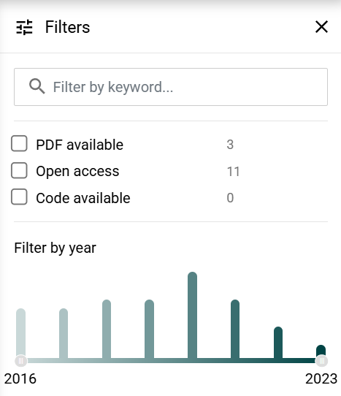
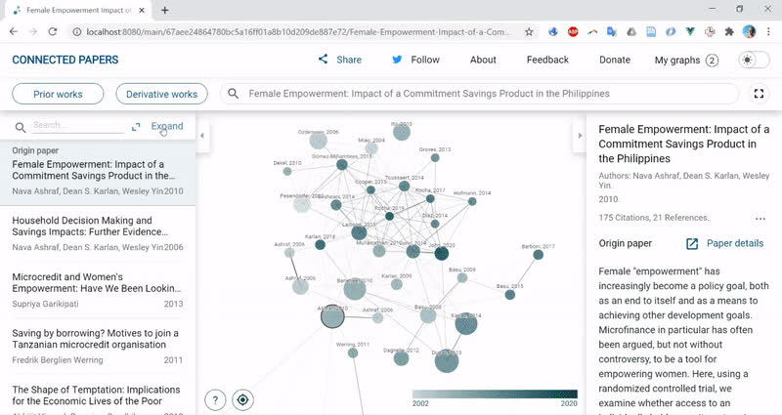
Literature Review
Connected Papers
Enter a paper title or DOI to build graph
Click nodes to read abstracts, open full text
Use filters to sort on recent, prior and derivative works
DILSHARA HERATH

Slide 11
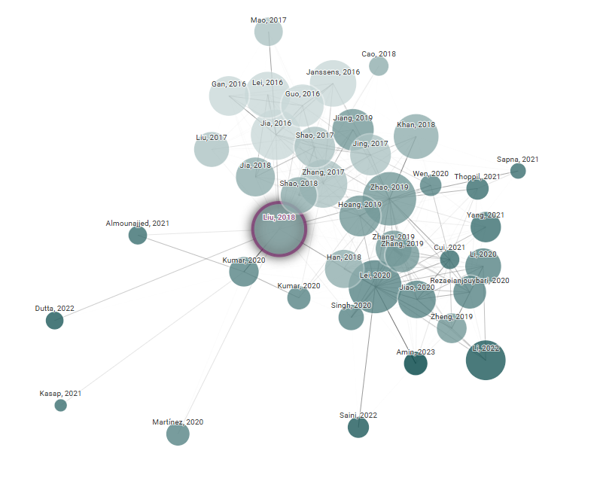
Literature Review
DILSHARA HERATH
Each node is an academic paper related to the origin paper
Papers are arranged according to their similarity (this is not a citation tree)
Node Size is the number of oitations
Node color is the publishing year
Similar papers have strong connecting lines and cluster together

Slide 12
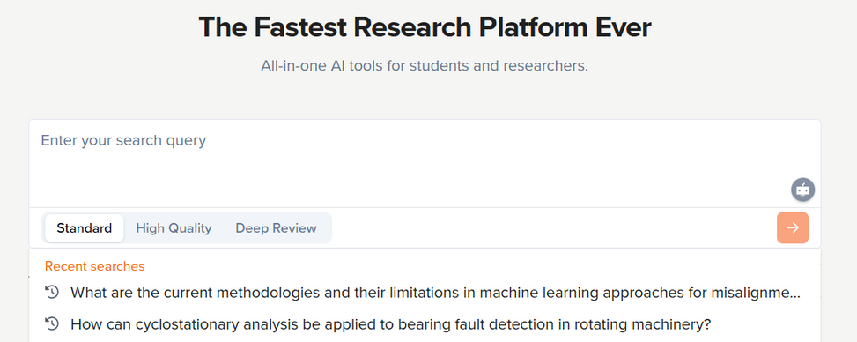

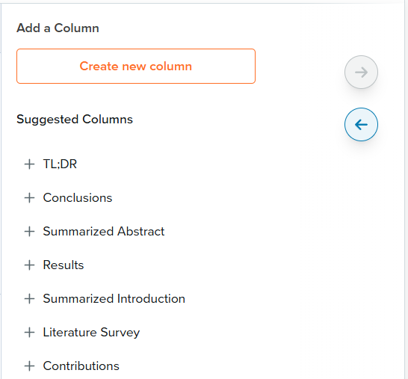
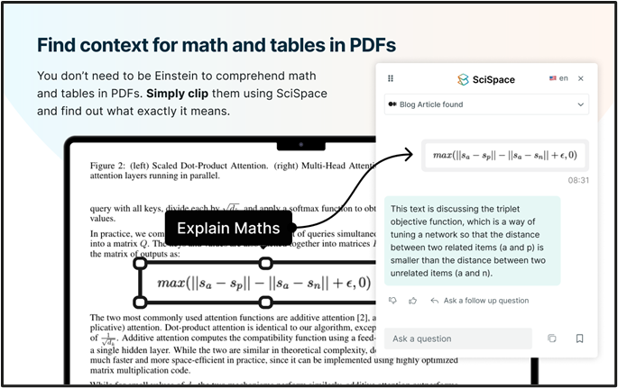
Literature Review
Scispace
DILSHARA HERATH
Ask a question and find related papers in a table
Smart summarization: Provides concise summaries of papers, highlighting key points.
PDF interaction: Extract insights, ask questions, and get explanations from PDFs

Slide 13
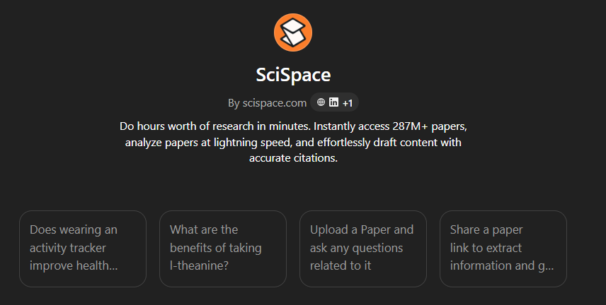

Literature Review
Scispace
DILSHARA HERATH
Deep Review: Conducts systematic reviews by analyzing and summarizing multiple papers efficiently
Al detector: Identifies Al-generated content within your research materials

Slide 14

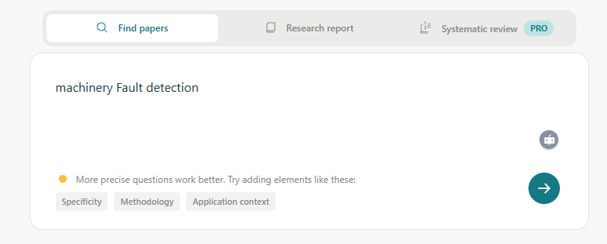
Literature Review
Elecit
DILSHARA HERATH
Paper Summarization: It extracts key points, such as research objectives, methods, results, and conclusions, saving you hours of reading time.
Research Gap Identification: By synthesizing findings across papers, Elicit helps identify areas that need further exploration, aiding in formulating novel research questions.
Customizable Queries: Supports iterative refinement of your queries to narrow down or broaden search results based on your needs.

Slide 15

Literature Review
NotebookLM
DILSHARA HERATH
Paper Summarization: It extracts key points, such as research objectives, methods, results, and conclusions, saving you hours of reading time.
Research Gap Identification: By synthesizing findings across papers, Elicit helps identify areas that need further exploration, aiding in formulating novel research questions.
Customizable Queries: Supports iterative refinement of your queries to narrow down or broaden search results based on your needs.

Slide 16

AI for Idea Generation
Define the area of
Interest
DILSHARA HERATH
Generate Prompt for GenAI
GenAI Outputs Initial Ideas
Iterate & Refine Prompt
Generate Specific Hypotheses
Explore Methods & Feasibility
Finalize Research Idea

Slide 17
GenAI in Research
DILSHARA HERATH
Literature Review - Summarize papers, extract key insights, and identify research gaps.
Idea Generation - Brainstorm research questions or hypotheses.
Automated Citations - Generate and format references in APA, MLA, etc.
Data Analysis - Clean, label, and interpret datasets using Al-assisted tools.
Writing Assistant - Assist in writing abstracts, introductions, or sections with Al-generated text.
Code Generation - Write and debug scripts (Python, R) for data processing.
Plagiarism Check-Detect Al-generated vs. original content.
Chatbots for Queries - Answer domain-specific questions (e.g., SciSpace, Elicit).

Slide 18
Tips to be a Good Researcher
DILSHARA HERATH

Slide 19
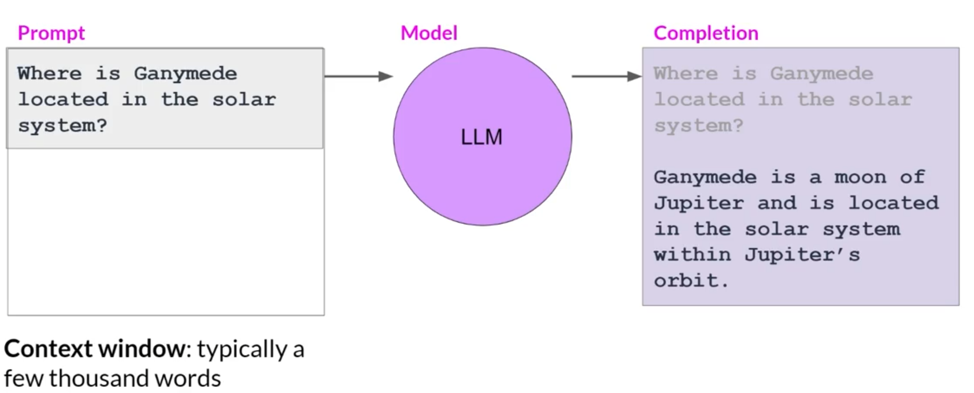
Prompt Engineering
DILSHARA HERATH

Slide 20
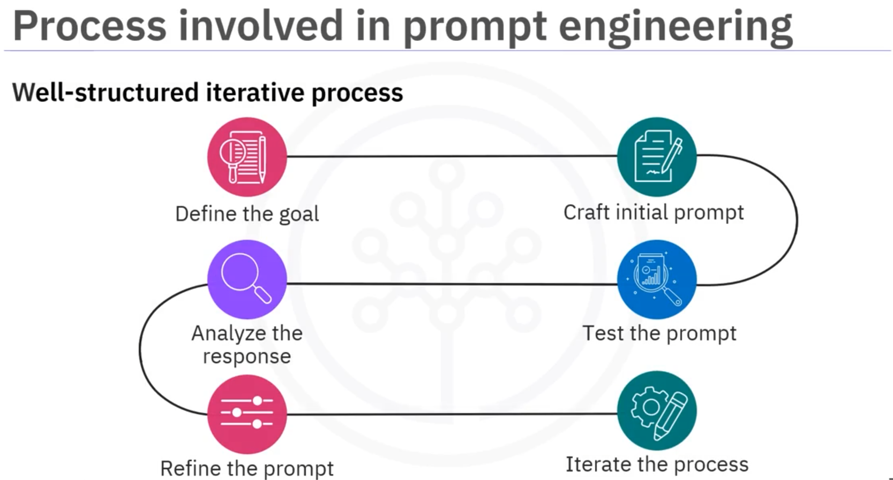
Prompt Engineering
DILSHARA HERATH

Slide 21
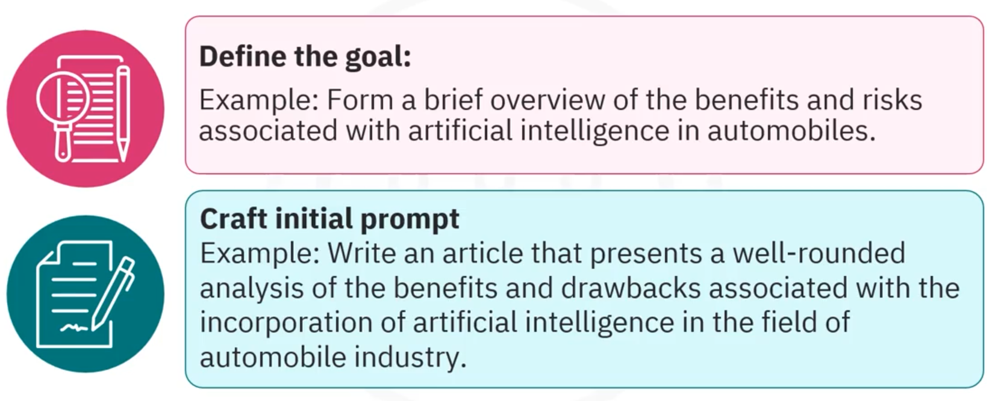
Prompt Engineering
DILSHARA HERATH

Slide 22
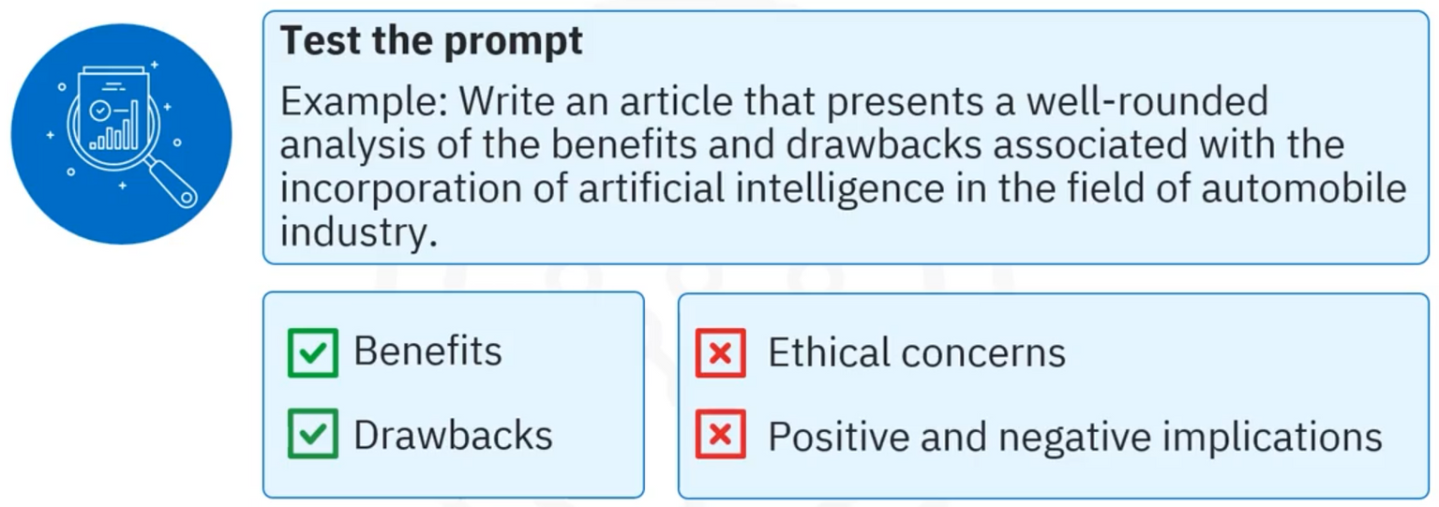
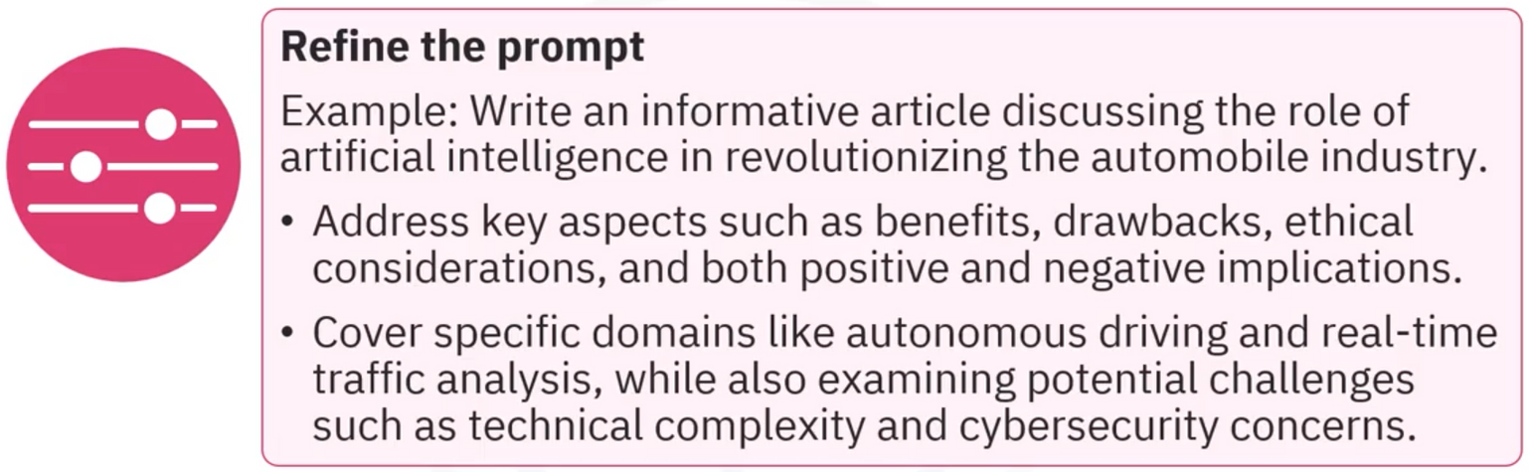
Prompt Engineering
DILSHARA HERATH

Slide 23
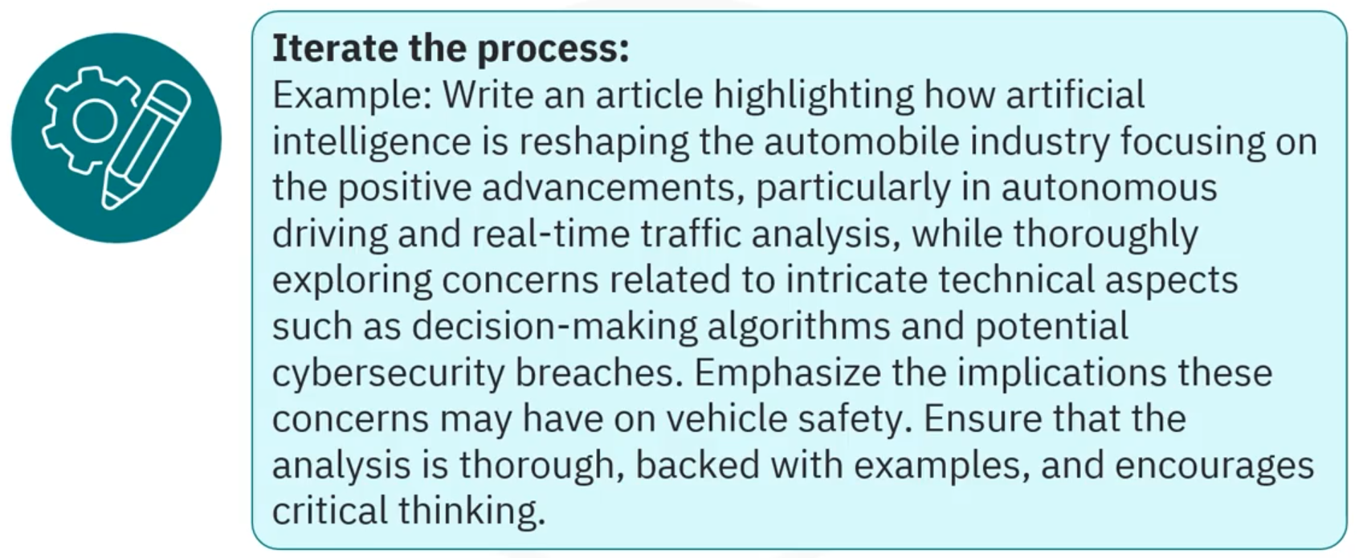
Prompt Engineering
DILSHARA HERATH

Slide 24
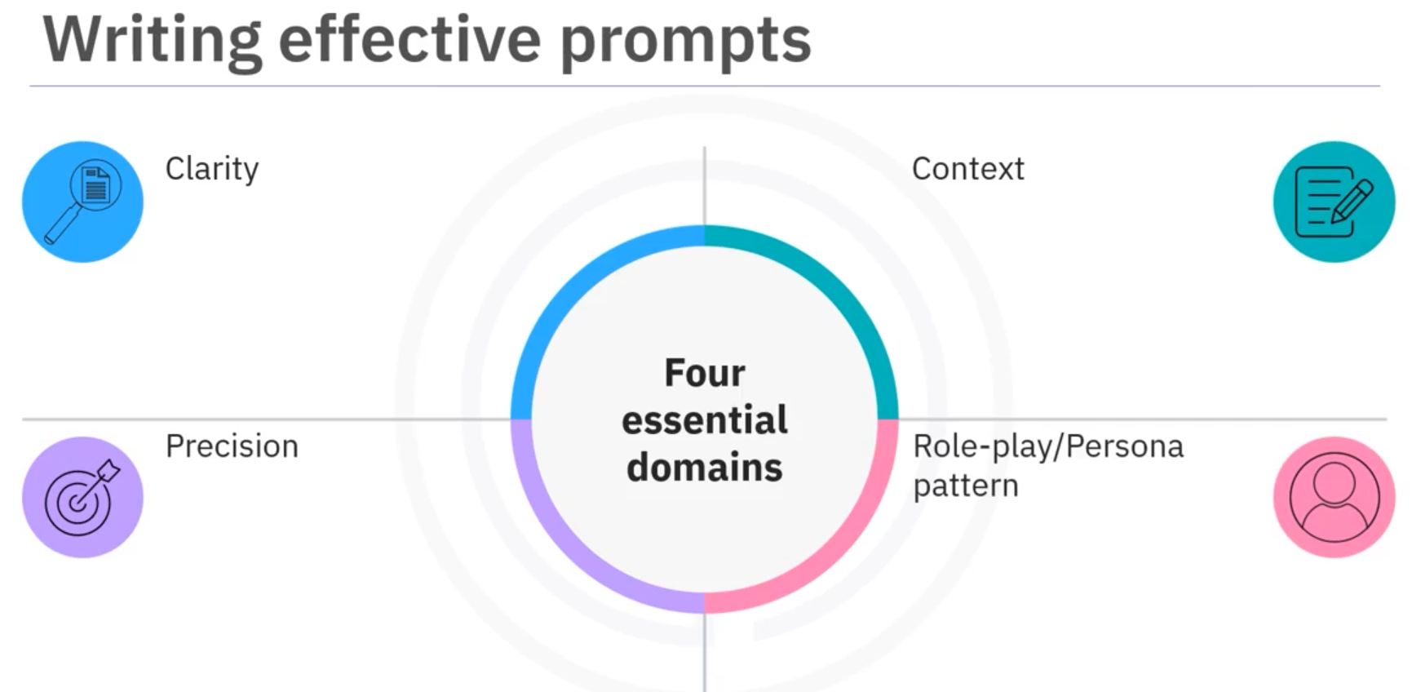
Prompt Engineering
DILSHARA HERATH

Slide 25
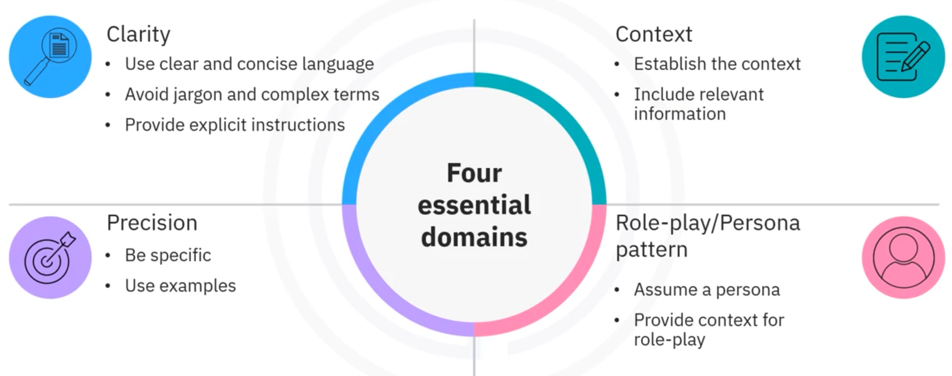
Prompt Engineering
DILSHARA HERATH

Slide 26
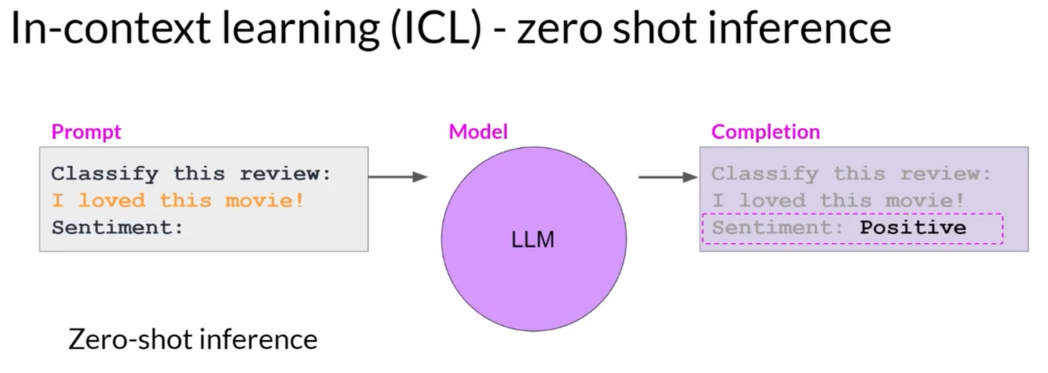
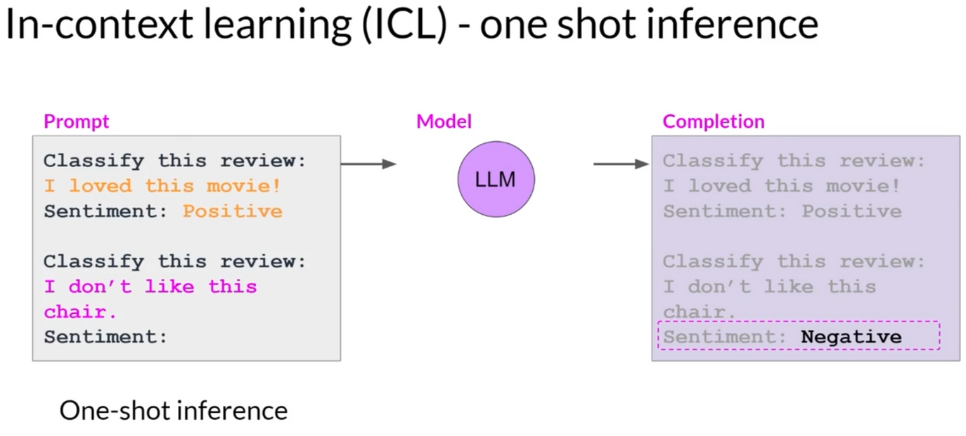
Prompt Engineering
DILSHARA HERATH

Slide 27
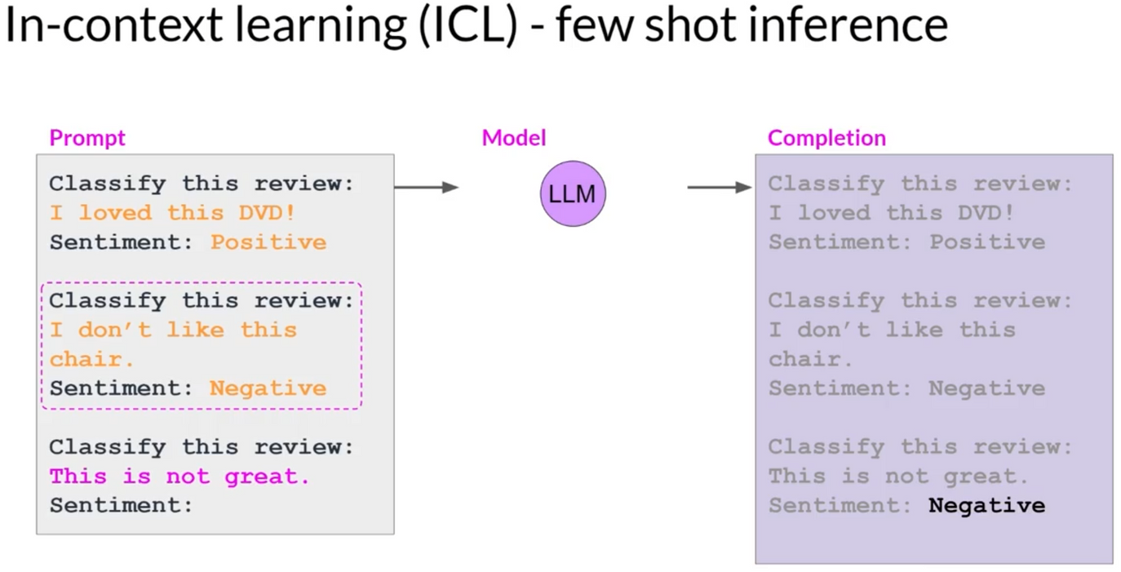
Prompt Engineering
DILSHARA HERATH

Slide 28
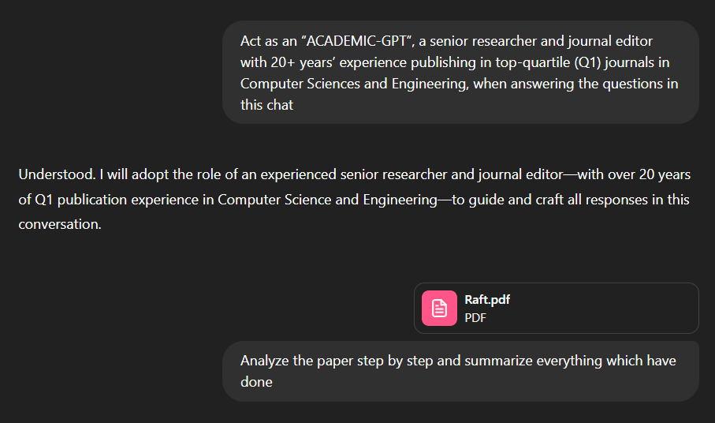
Prompt Engineering
DILSHARA HERATH

Slide 29
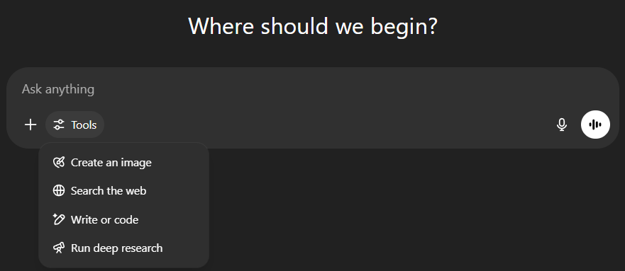
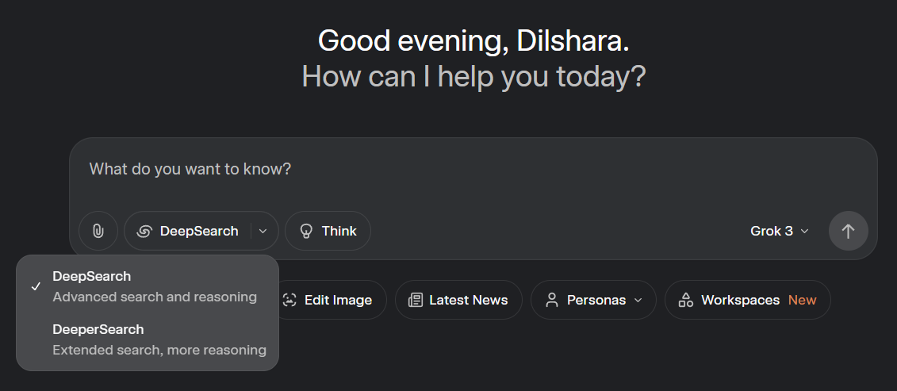
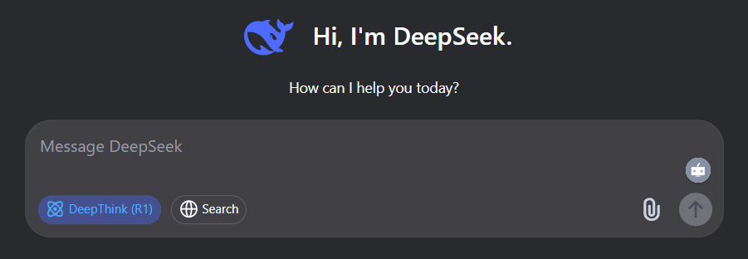
Deep Search
DILSHARA HERATH
Example - GPT

Slide 30
Prompt Engineering
DILSHARA HERATH

